Slide 1
Biotechnology for Environmental Engineers
Prof. Wenyu Gu
wenyu.gu@epfl.ch
October 6th

Slide 2
Today’s content:
Energetics for biological systems.
Examples of biotechnology (for environmental engineers)
– how to evaluate a process as good or bad?

Slide 3
What’s the similarity between the burning sugar experiment and when we digest sugar?
https://www.youtube.com/watch?v=sZiYnRMdvG0
What’s the difference?

Slide 4
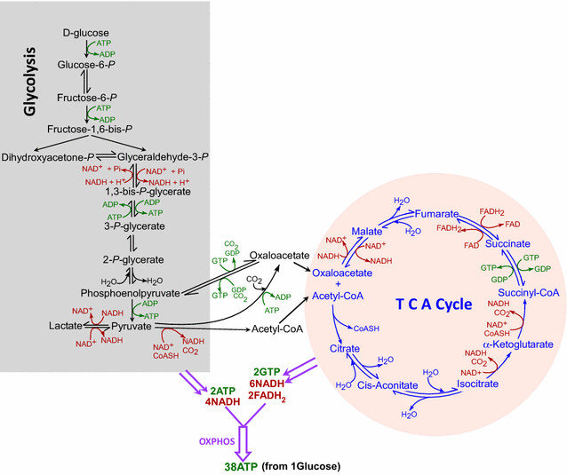

Slide 5
Where does chemical energy come from?
A quote by Nobel Prize-winning biochemist Albert Szent-Györgyi: "Life is nothing but an electron looking for a place to rest”
What is Redox Reaction? https://www.youtube.com/watch?v=lQ6FBA1HM3s
A redox reaction (short for reduction–oxidation reaction) is a chemical reaction in which electrons are transferred between two chemical species.
It always involves two processes happening at the same time:
Oxidation → loss of electrons
  The species that loses electrons is the reducing agent (it gets oxidized).
Reduction → gain of electrons
  The species that gains electrons is the oxidizing agent (it gets reduced).
  Always need an electron donor and an electron acceptor!

Slide 6
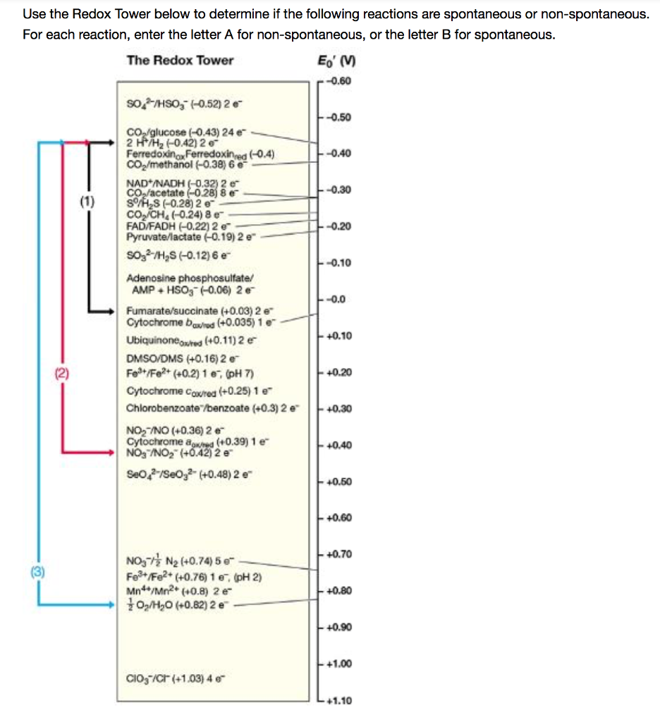
What are the two sources of energy for life?

Slide 7
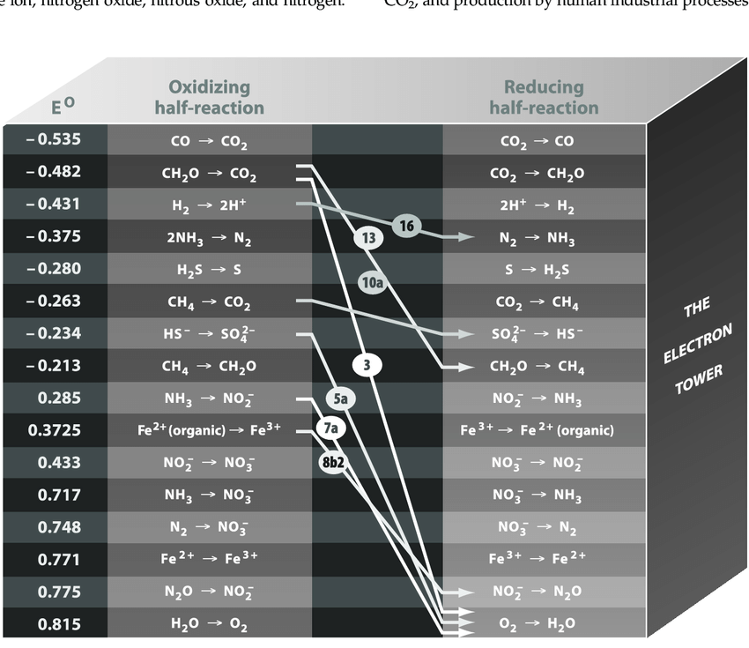
What are some common chemicals you see on this tower?
Where is O₂?
Where is sugar?
Notes:
~30 ATP per glucose + O2

Slide 8
What does it mean if two half reactions are far apart on the tower?
Why is not all life forms based on the couples furthest apart?
Notes:
~30 ATP per glucose + O2

Slide 9
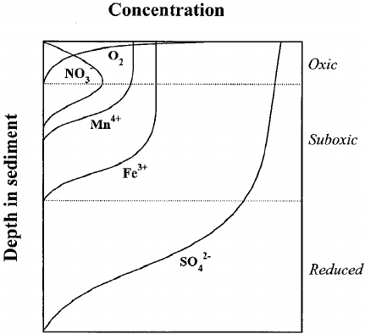
The chemical profile along the depth of soil or water in nature:
Why would such profile happen?

Slide 10
Biological system is not perfect, is there room for improvement?
C6​H12​O6​+6O2​→6CO2​+6H2​O
The standard free energy change (ΔG∘) is approximately −2870 to −2880 kJ/mol of glucose.
Standard Gibbs Free Energy (ΔG∘ ) for ATP Synthesis: The synthesis of ATP from ADP and inorganic phosphate (Pi​) is an endergonic reaction that requires an input of energy:
ADP+Pi​→ATP+H2​O
The standard free energy change (ΔG∘) for this reaction is approximately +50-70 kJ/mol of ATP.
Maximum Theoretical ATP= 40-50 ATP molecules
Reality: 32 ATP / glucose

Slide 11
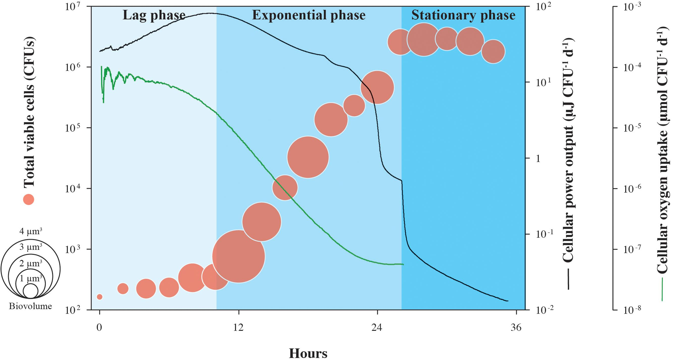

Slide 12
What are other possibility of chemical energy?
(How can microorganisms live where we can not live?)
Notes:
Anything going downhill is possible?

Slide 13
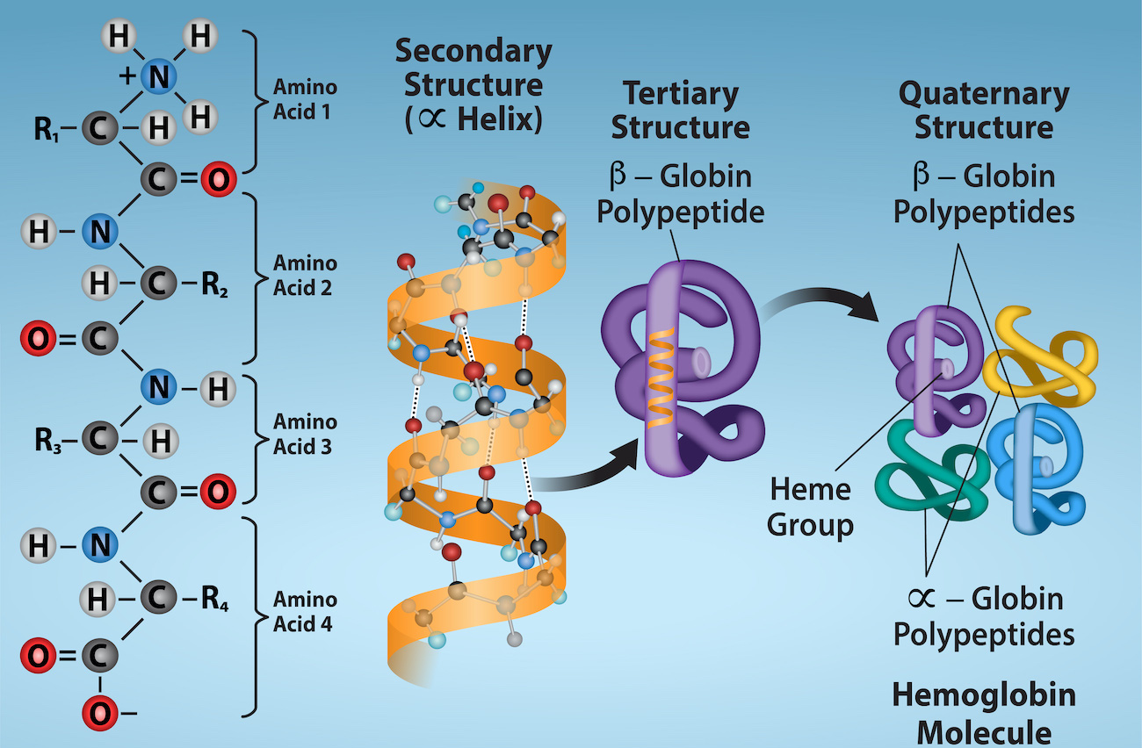
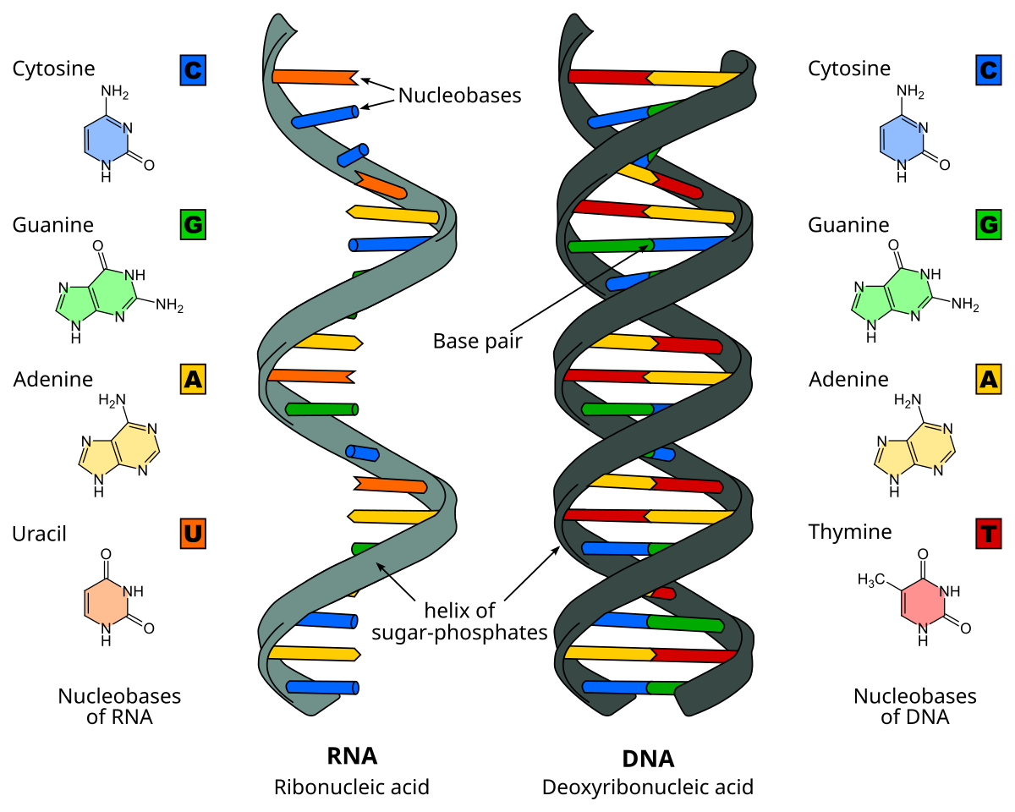
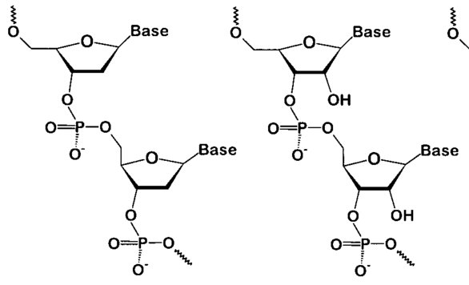
After receiving the energy for life, what else are needed?

Slide 14
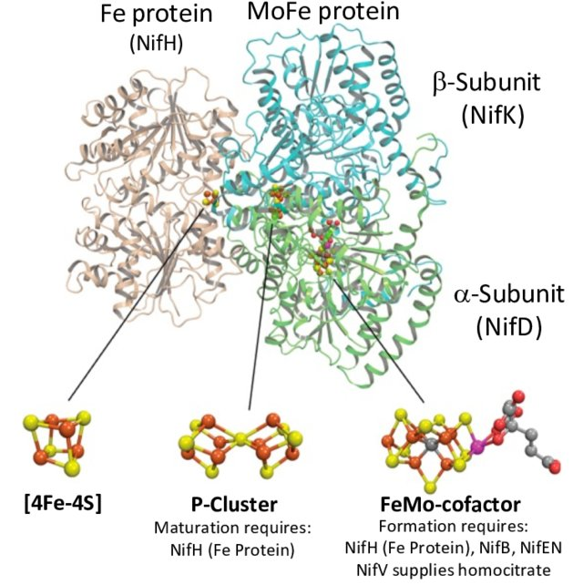
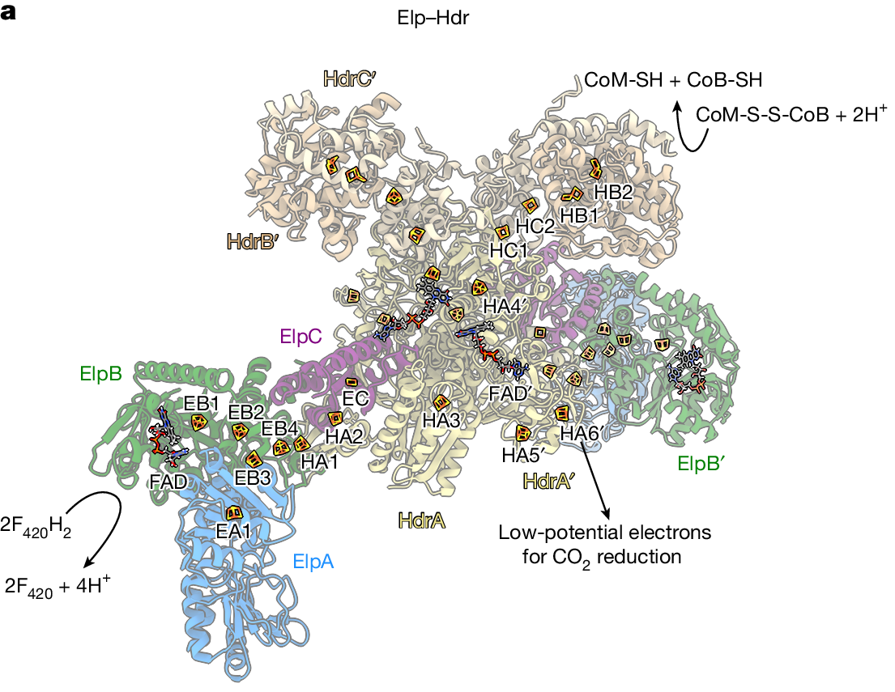
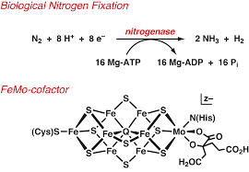
After receiving the energy for life, what else are needed?
Notes:
Biological nitrogen fixation is a crucial process where specialized microorganisms, such as Rhizobium in legumes and free-living cyanobacteria, convert atmospheric nitrogen gas (N₂)—which most organisms cannot use—into ammonia (NH₃), a form that plants and other organisms can assimilate to build proteins, nucleic acids, and other biomolecules. This process is vital for replenishing the nitrogen available in ecosystems, sustaining soil fertility, and supporting global food production. Without biological nitrogen fixation, life would face a severe shortage of usable nitrogen, limiting growth and productivity in natural and agricultural systems.
industrial Haber–Bosch process, it occurs naturally under ambient temperature and pressure using the enzyme nitrogenase, requiring far less energy. While the Haber–Bosch process produces large amounts of ammonia for fertilizers, it is extremely energy-intensive, relies on fossil fuels, and contributes to greenhouse gas emissions. In contrast, biological fixation is sustainable, environmentally friendly, and supplies ecosystems with usable nitrogen without harming the environment. However, the industrial process can produce nitrogen fertilizers on a massive scale to meet global food demands, whereas biological fixation is limited by the activity of specific microorganisms and their associations with plants. The Haber–Bosch process is extremely energy‐intensive: it is estimated to consume about 1-2 % of the world’s total energy supply.

Slide 15
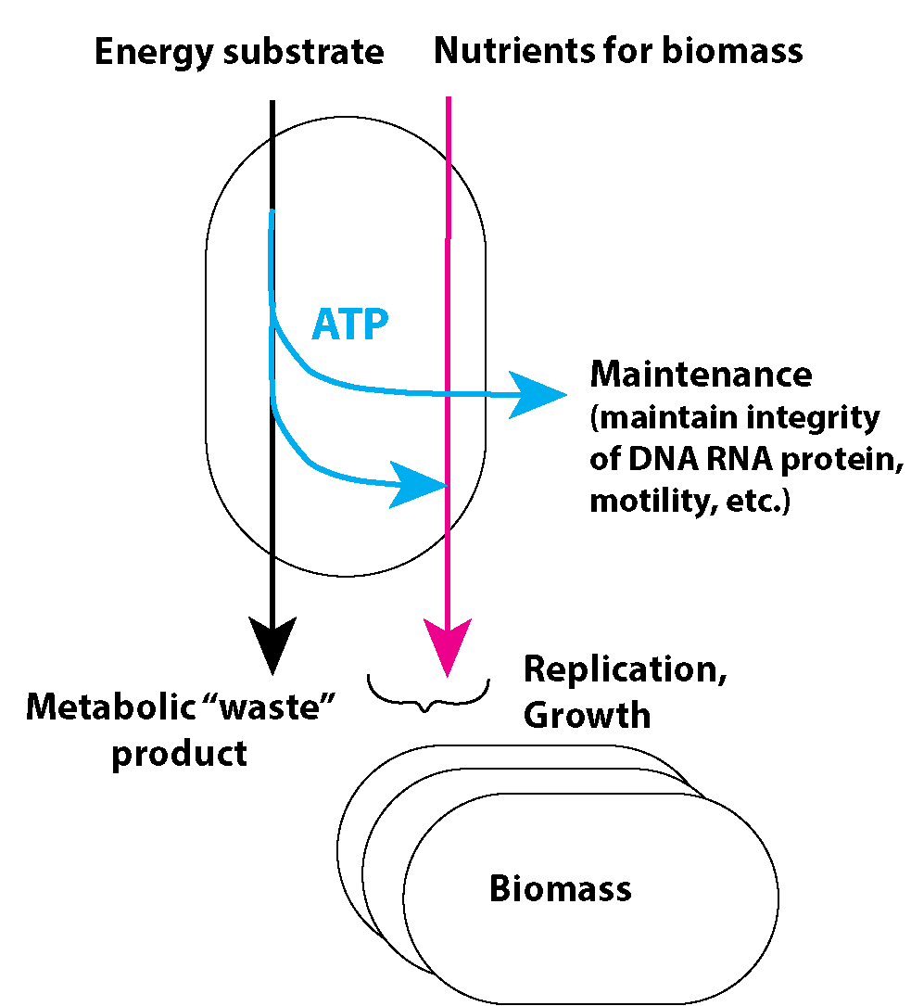
How is energy production connected to growth?

Slide 16
Consider two scenarios:
A microbe that eats glucose and O₂ for energy.
A microbe that eats H₂ and CO₂ for energy.
If we apply them in biotechnology to produce valuable products, which organism would you choose for maximizing biomass production, and which would be more suitable for generating metabolic products?

Slide 17
Rate, Yield, Selectivity → define the chemistry or biology reaction
A microbe that eats glucose and O₂ for energy.
A microbe that eats H₂ and CO₂ for energy.
Notes:
Rate – how fast the reaction or process occurs (kinetics, throughput).
Yield – how much desired product is obtained relative to the theoretical maximum.
Selectivity – how much of the desired product is formed compared to unwanted by-products.

Slide 18
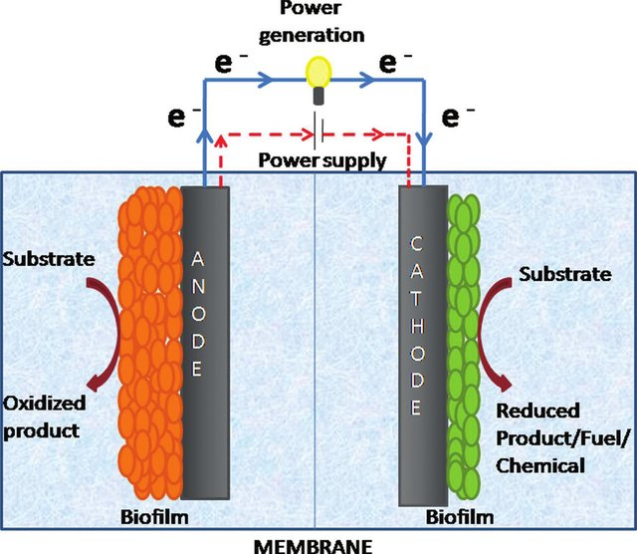
Is it possible to use only half reaction to support microbial growth?
Renewable electricity (solar, wind, hydro, nuclear) is the cleanest and most scalable primary energy we can generate without carbon emissions.
Electrifying sectors means: instead of burning fossil fuels, they run directly or indirectly on electrons provided by renewables.

Slide 19
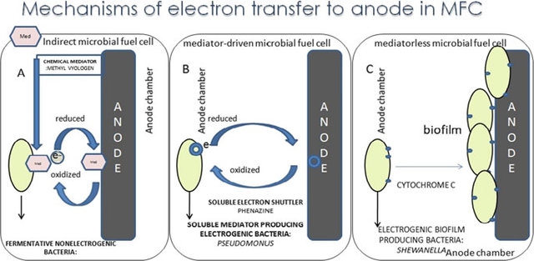
Mechanisms of direct electron transfer

Slide 20
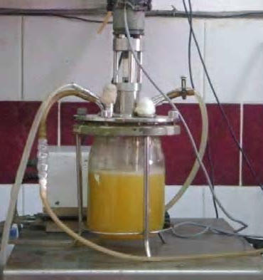
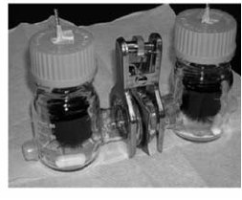
Examples of traditional bioreactor vs. electrochemical-based bioreactor

Slide 21
Above:
What provides energy for (microorganisms) life?
What is a good biotechnology process? With examples!
Rate, Yield, Selectivity → define the chemistry or biology reaction
Productivity, Efficiency → define the engineering viability.
Return, Reliability/Risk → define the economic & practical success
Next:

Slide 23
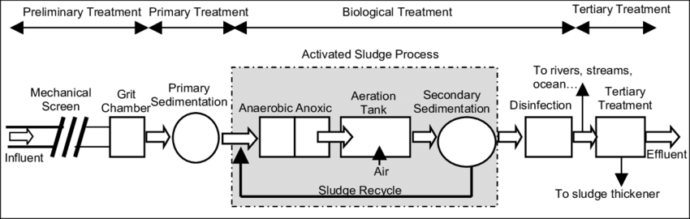
(One of) the most successfully applied biotechnology: Wastewater treatment process
What are the chemical energy in wastewater?
What else is needed?
Notes:
can remove 85–95% BOD/COD

Slide 24
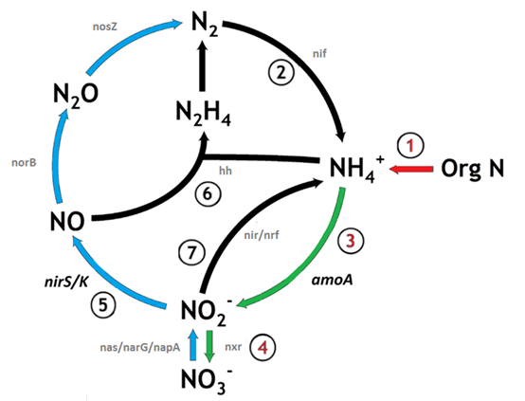
Focus on carbon and nitrogen removals:
How do we remove carbon?
How do we remove nitrogen?
Nitrification: Ammonia (NH₄⁺) → nitrite (NO₂⁻) → nitrate (NO₃⁻)
Denitrification: NO₃⁻ → N₂ gas
Same color of arrows means the steps are carried out by same kind of microbes.

Slide 25
Focus on carbon and nitrogen removals:
Starting material organic carbon and ammonia:
(1)
Aerobic tank: O₂
Anoxic tank: No O₂
wastewater
(2)
Anoxic tank: No O₂
Aerobic tank: O₂
wastewater

Slide 26
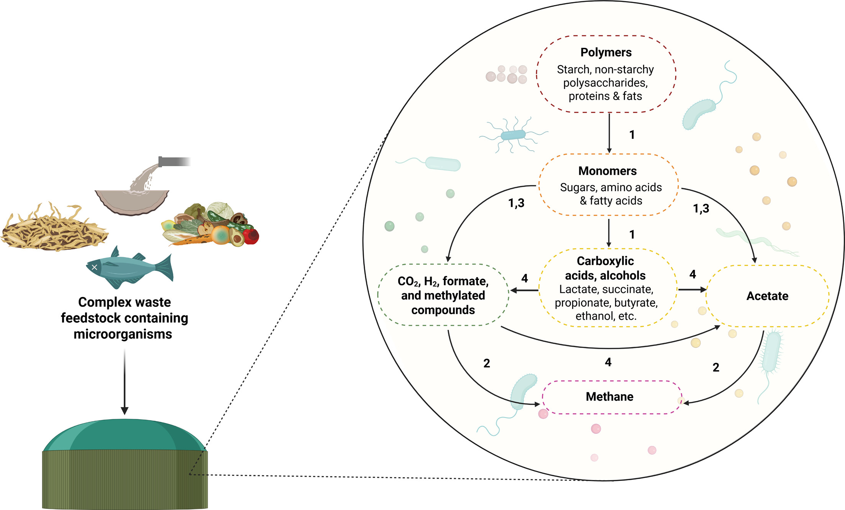
(Another one of) the most successfully applied biotechnology: Anaerobic digestion of sludge for biogas production

Slide 27
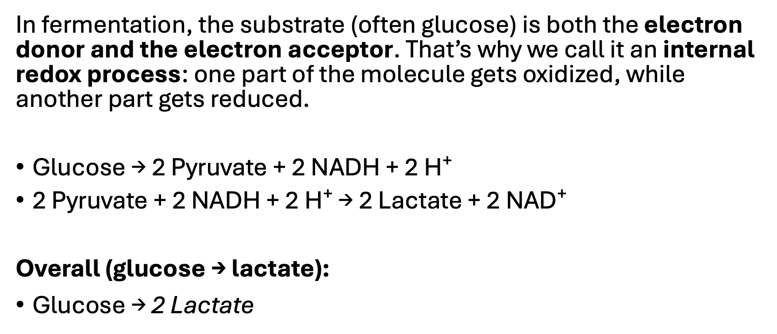
Peculiar case of anaerobic digestion: where is the other half redox reaction??
In fermentation, the substrate (often glucose) is both the electron donor and the electron acceptor. That’s why we call it an internal redox process: one part of the molecule gets oxidized, while another part gets reduced.
Glucose → 2 Pyruvate + 2 NADH + 2 H⁺
2 Pyruvate + 2 NADH + 2 H⁺ → 2 Lactate + 2 NAD⁺
Overall (glucose → lactate):
$\text{Glucose}\text{ → 2 }\text{Lactate}$

Slide 28
Global sampling efforts on anaerobic digestion:
https://www.midasfieldguide.org/guide
The global MiDAS campaign (2018-2021) including more than 740 activated sludge plants and 280 anaerobic digesters has resulted in the development of MiDAS 4 - a near-complete reference database of microbes from wastewater treatment plants across the world (Dueholm et al., 2022), that was recently updated to MiDAS 5 to include microbes from anaerobic digesters around the world (Dueholm et al., 2024).

Slide 29
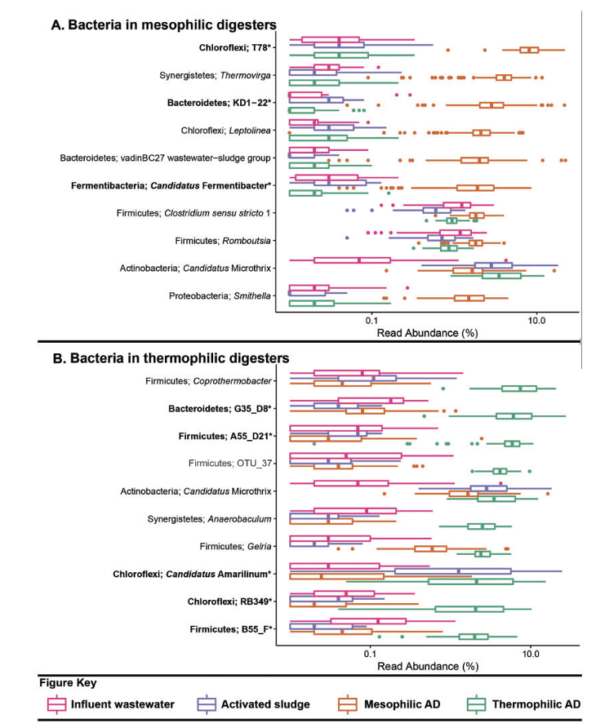
How do we make sense of this diverse community of microorganisms?

Slide 30
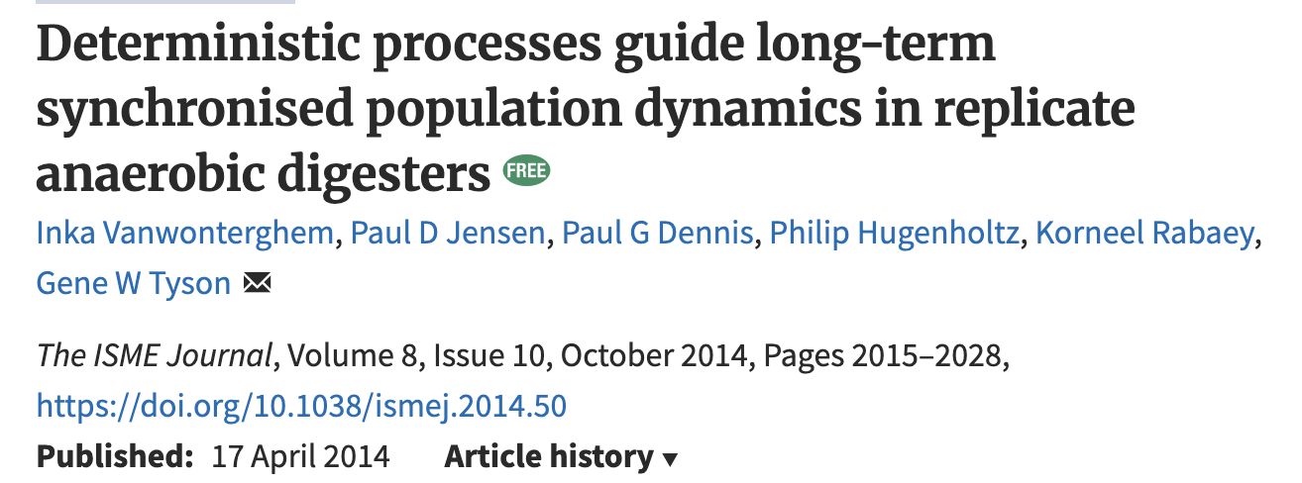
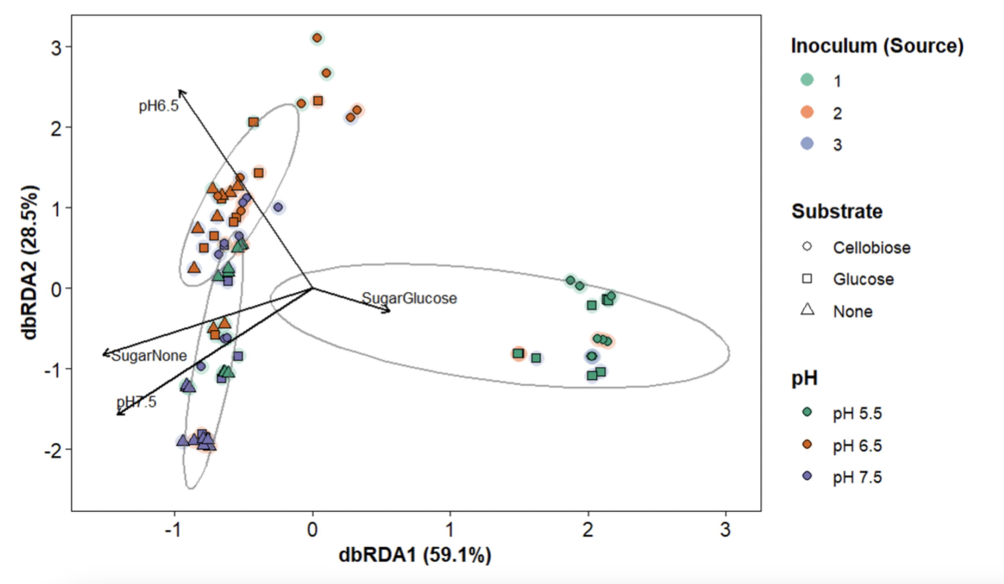
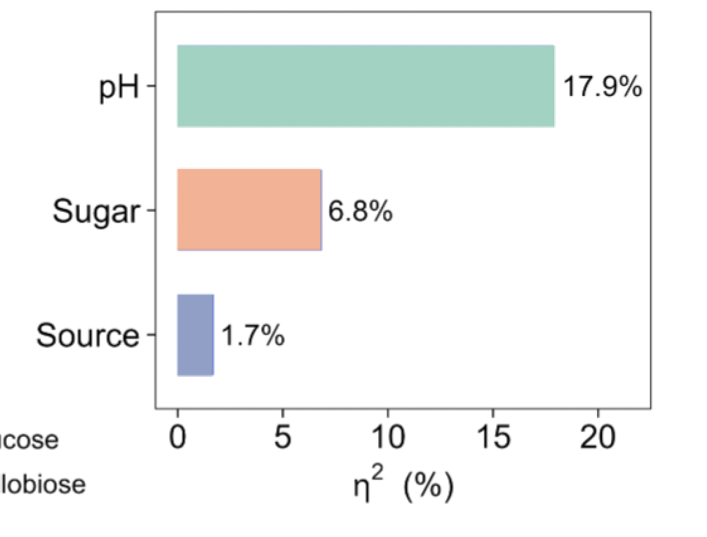
If we focus on the products rather who is there:
Metabolic pathways are modular and finite!

Slide 31
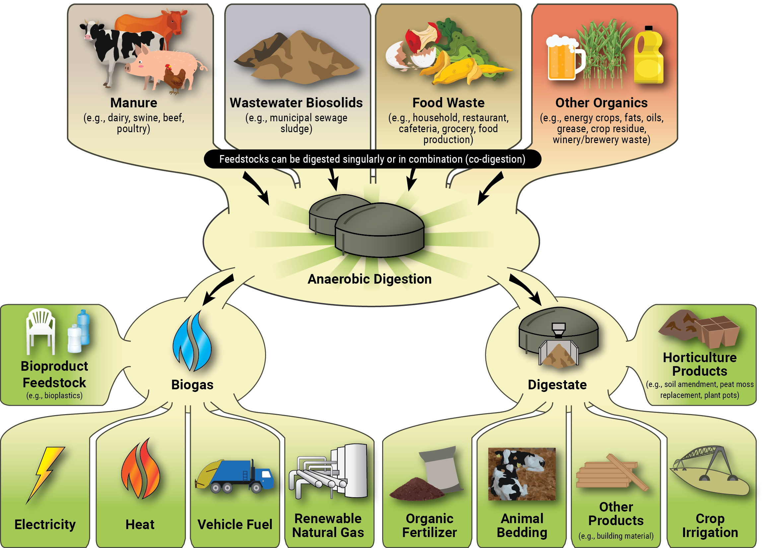
What is new opportunities for anaerobic digestion?
Produce reduced compounds with energy stored in it:

Slide 32
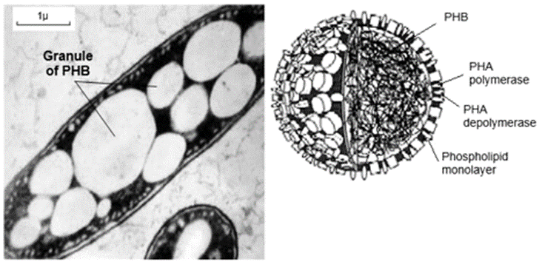
One example of downstream use of AD products– production of bioplastics
Acids + O2 → Biomass (bioplastics) + CO2
A plastic derived from biological substances rather than from petroleum, many types of which are biodegradable.

Slide 33
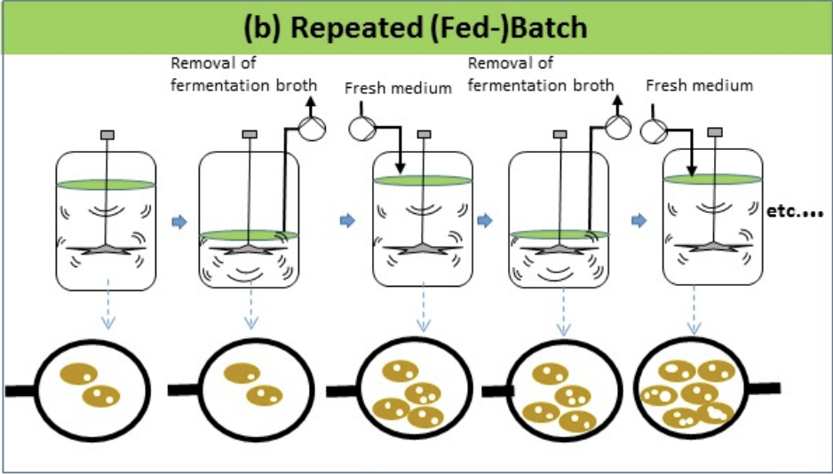
Some bacteira naturally have the ability to produce bioplastics, how could we “select” them among a mixture of bacteria community?
--- we need to understand their ecological function!
https://www.mdpi.com/2311-5637/4/2/30

Slide 34
Some new biotechnologies for sustainability:
CO₂ reduction
What could be a good electron donor?
What are our product options?

Slide 35
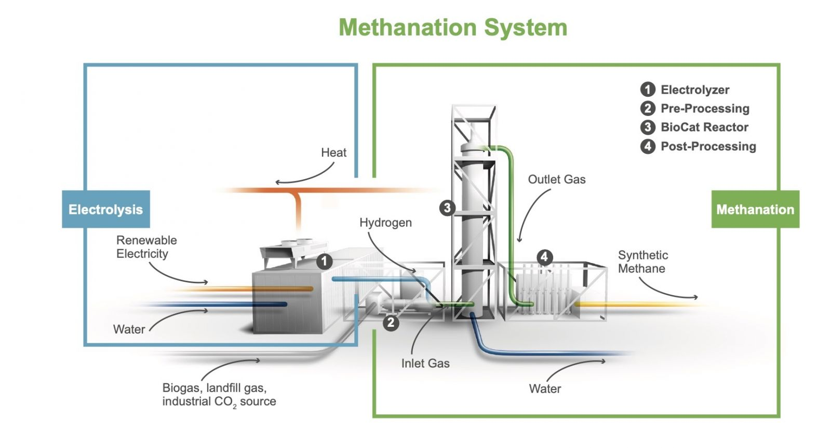
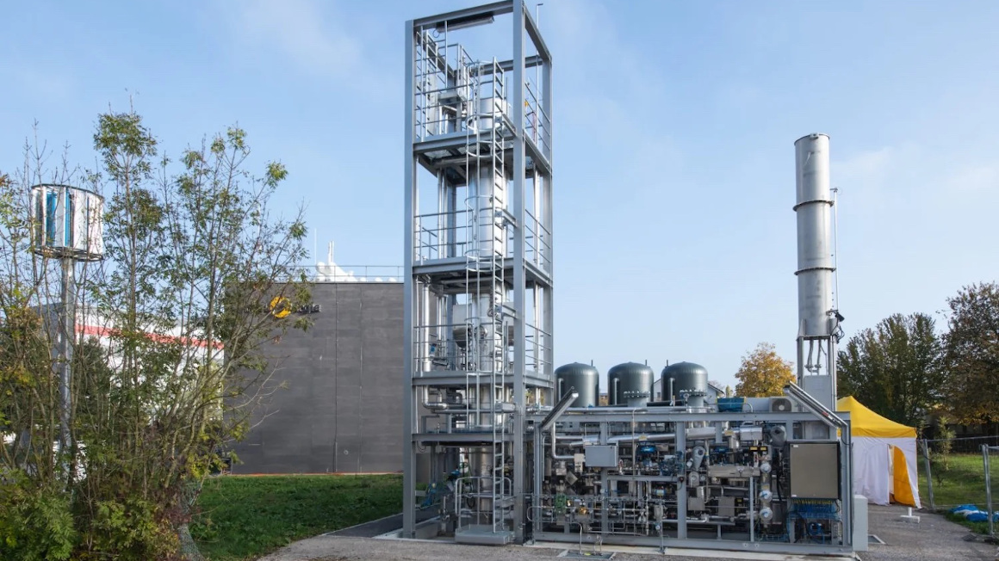
Power-to-X (gas: H₂, CH₄, acetate, protein)
Are we making a carbon-neutral or carbon-negative cycle?

Slide 36
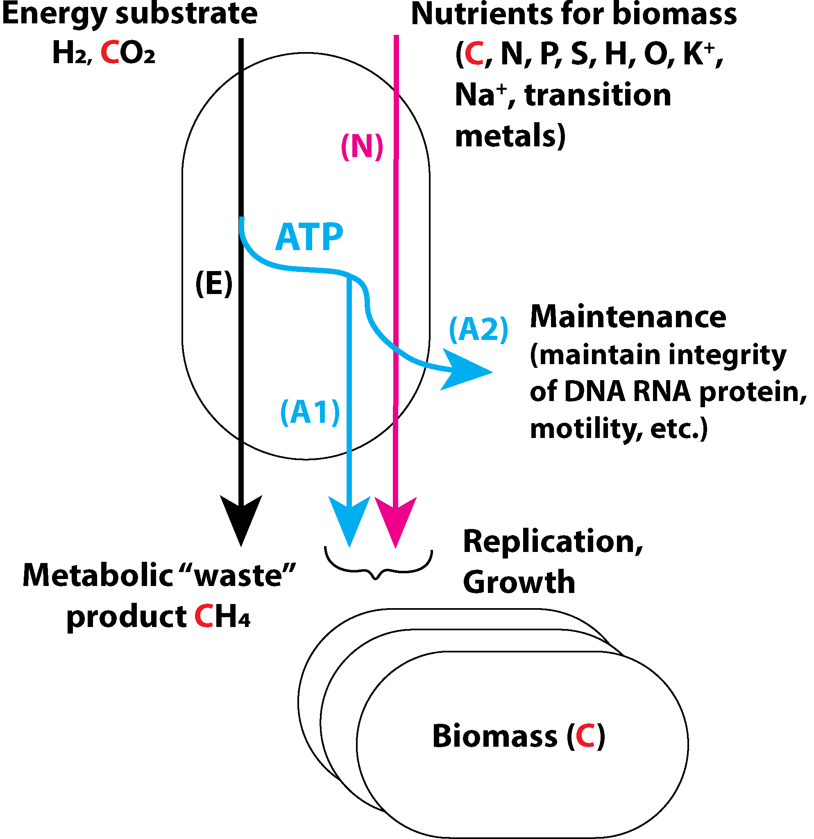
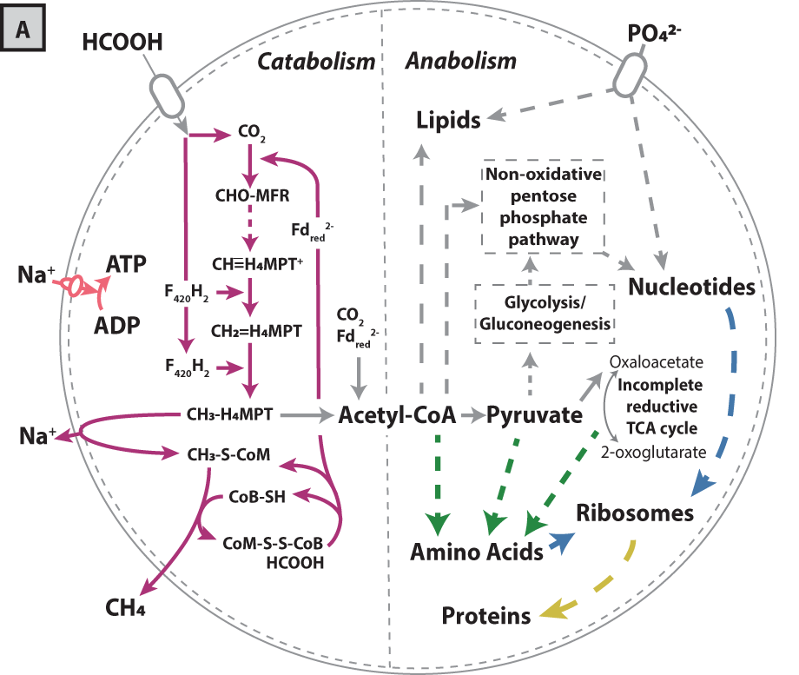
We could manipulate the carbon flow to CH₄ vs. biomass by nutrient limitation:
Notes:
Carbon assimilation proceeds mostly by combining the methyl-group from methyl-H₄MPT generated in the methanogenesis pathway with CO₂-derived CO in the carbon monoxide dehydrogenase/acetyl-CoA synthase (CODH/ACS) complex to produce acetyl-CoA

Slide 37
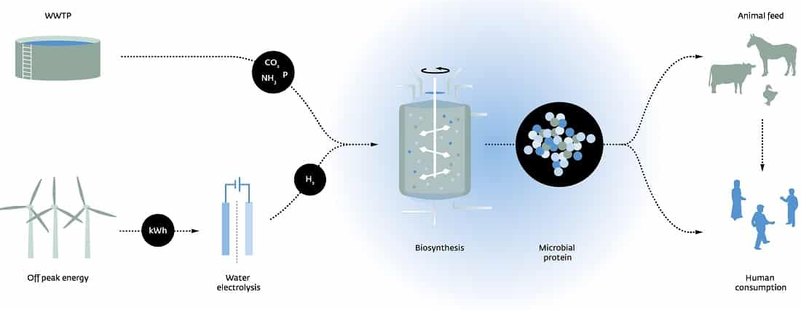
Power-to-Protein: why not make protein in one-step reaction?
Acetate

Slide 38
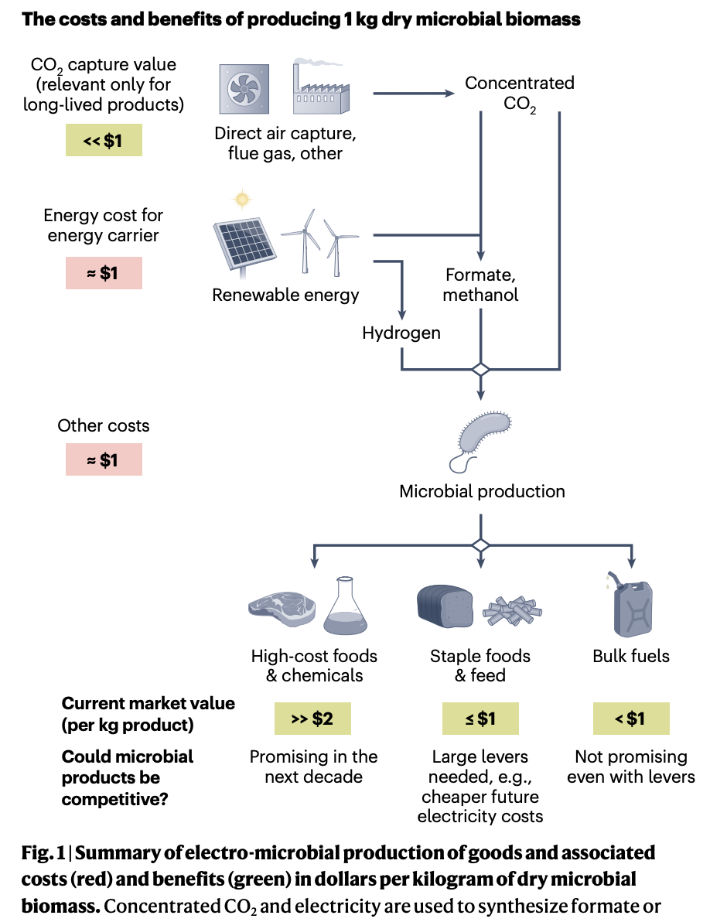
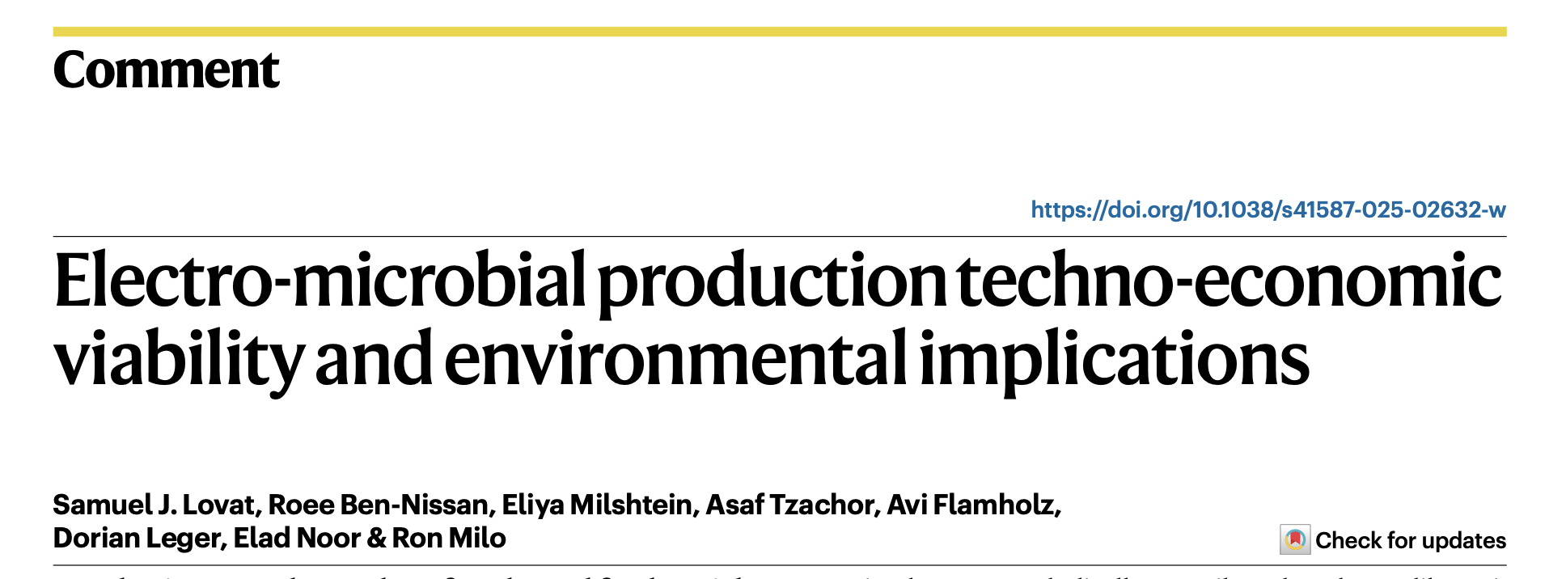
Producing goods, such as foods and fuels, with minimal environmental impacts is urgently needed. Although advances in bioproduction are promising, there is often a noticeable gap in our understanding of whether and where new processes can compete with existing methods on an economic and environmental basis. Transparent lower bound calculations from basic principles highlight potential benefits of producing foods, but not fuels, from electro-microbial production of biomass.

Slide 39
Production of ammonia
Haber-Bosch process, N2 ​(g) + 3H2 ​(g) ⇌ 2NH3​ (g)
reaction conditions:
Temperature: 400−500 degree C.
Pressure: 150−350 bar,
Catalyst: Iron
The Haber-Bosch process is extremely energy-intensive, consuming about 1–2% of global energy supply. The energy investment for the process has two main components:
Hydrogen Production Energy: The largest energy sink. Historically, H2​ is produced from natural gas (methane) via steam reforming, which is a high-temperature process and releases significant CO2​ emissions.
Synthesis Loop Energy: Energy required for compression (to maintain the high operating pressure) and heating (to maintain the high reaction temperature).

Slide 40
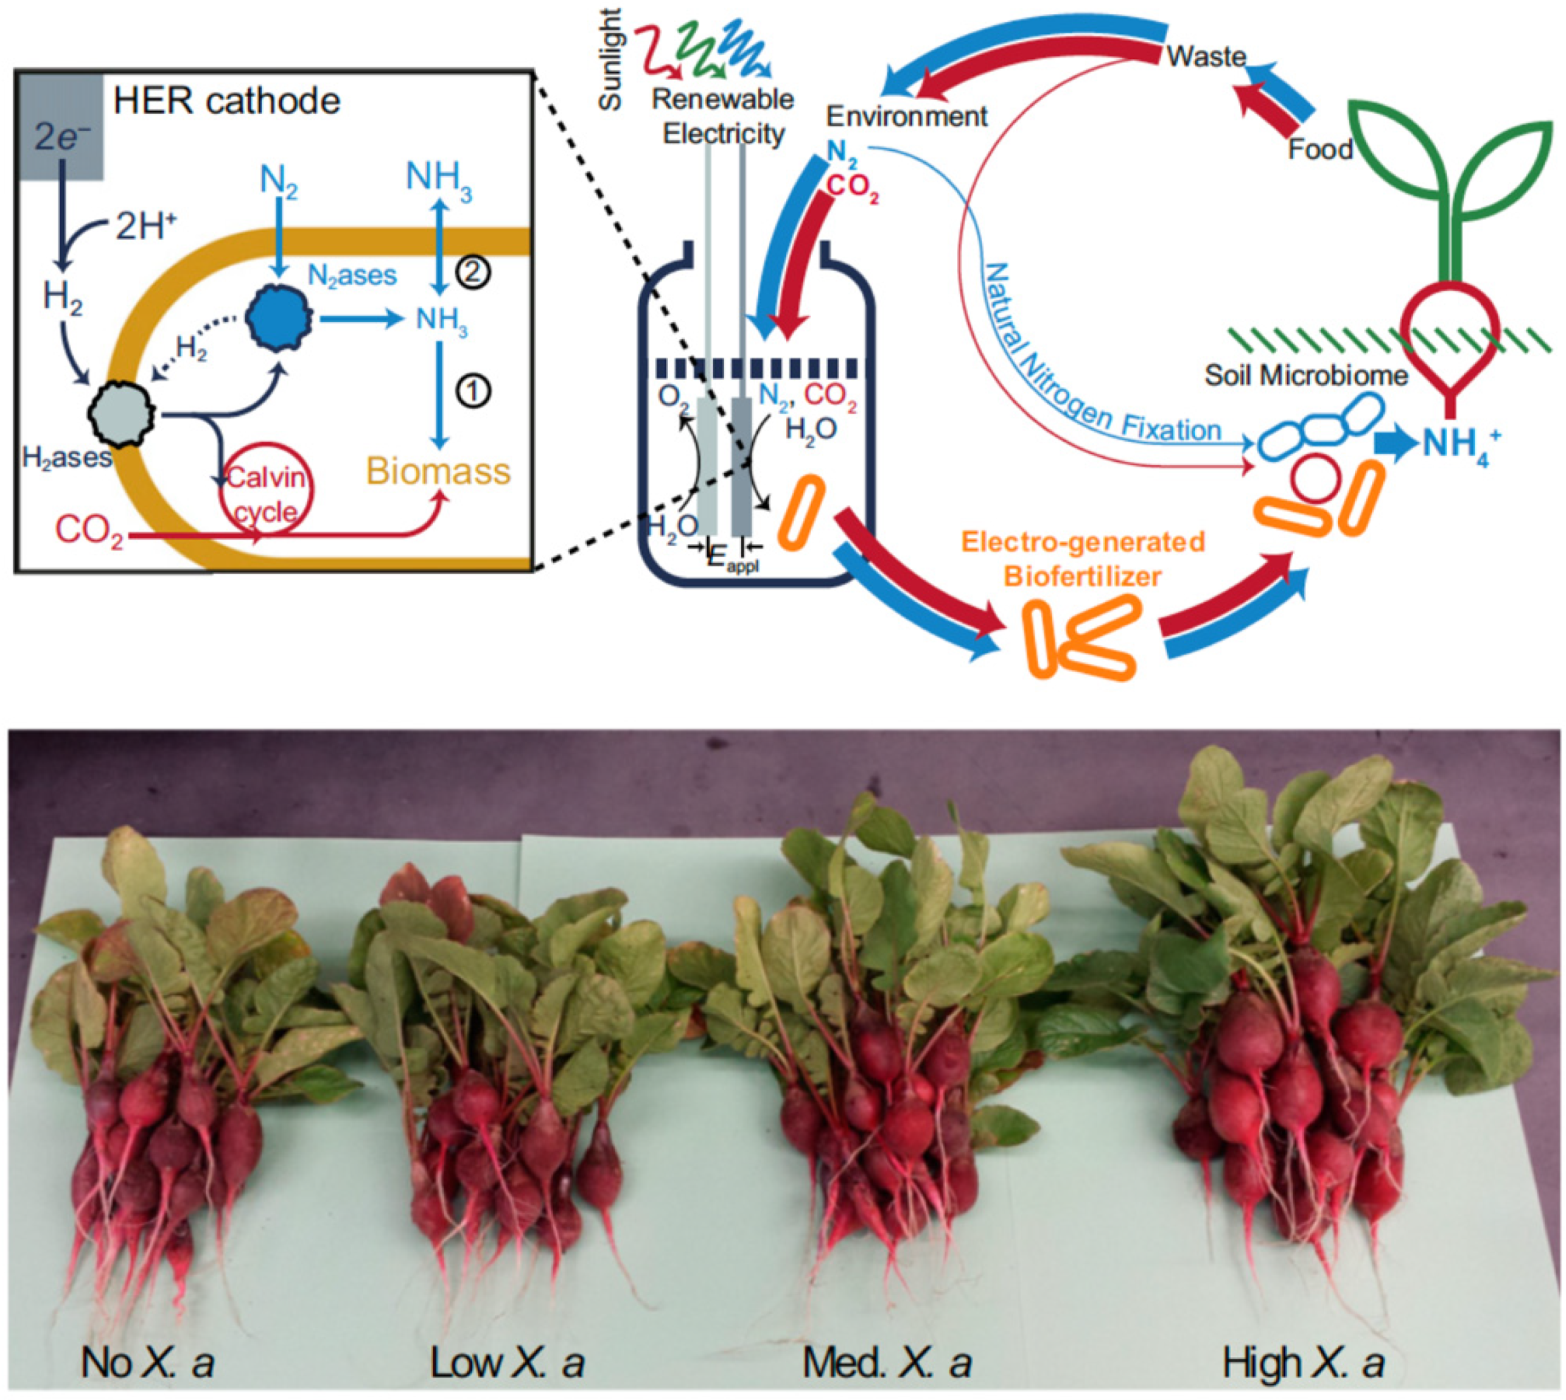
Electrification + nitrogense enzyme
Liu, C.; Sakimoto, K.K.; Colón, B.C.; Silver, P.A.; Nocera, D.G. Ambient nitrogen reduction cycle using a hybrid inorganic-biological system. Proc. Natl. Acad. Sci. USA 2017, 114, 6450–6455.

Slide 41
Agriculture-relevance
Nitrogen (N) is very commonly the most limiting nutrient for plant growth in many natural ecosystems and agricultural settings, after water.
The Nitrogen Bridge: Although the atmosphere is nearly 80% nitrogen gas (N2​), plants cannot use it directly.
Global Share: Ammonia production accounts for approximately 1.2% to 2% of global carbon dioxide (CO2​) emissions. This results in direct emissions of around 420 to 500 million tonnes of CO2​ annually.

Slide 42
Exercise:
What are the possible life form on Mars?
The atmosphere of Mars is composed primarily of carbon dioxide (about 95%),
smaller amounts of nitrogen (around 2.7%),
argon (around 1.6%),
plus trace gases like oxygen,
hydrogen,
carbon monoxide,
water vapor,
Minerals.

Slide 43
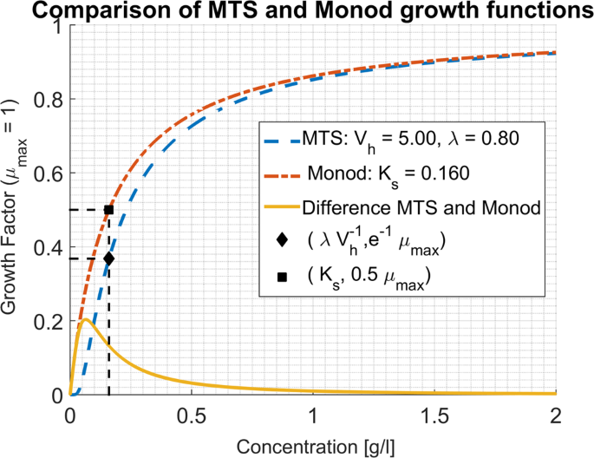
Reflection:
How does the concentration matter??
https://www.nature.com/articles/s41598-020-62213-6

